Slide 1
Java Architecture

Slide 2
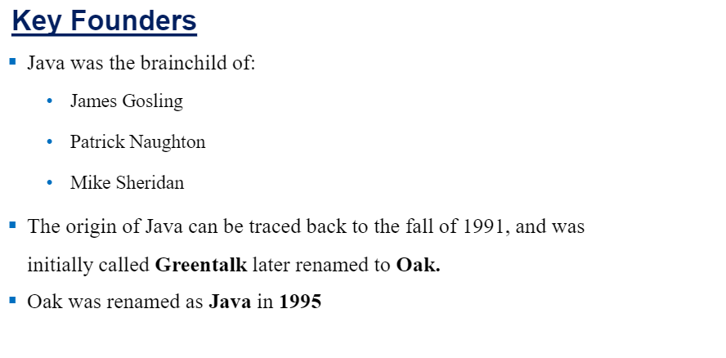
Evolution of Java

Slide 3
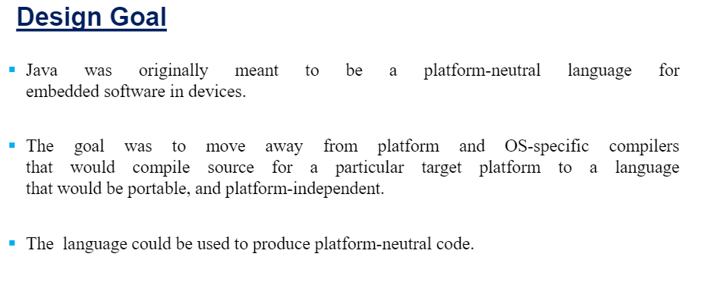

Slide 4
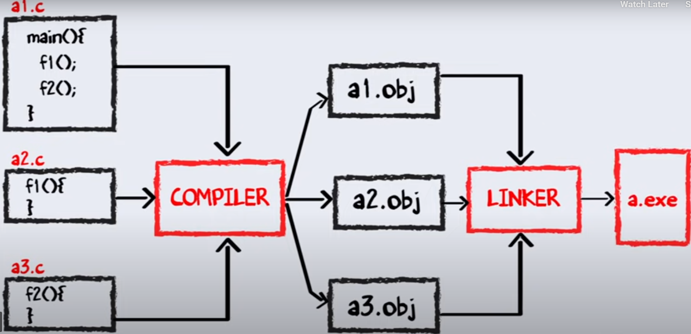

Slide 5
JAVA
Compiler compiles to .class files while no linking is done

Slide 6
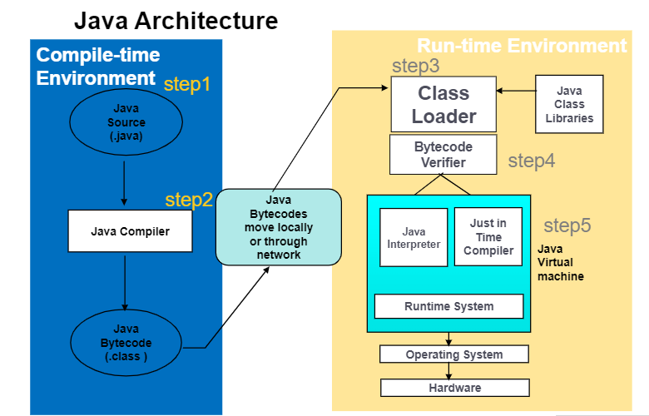

Slide 7
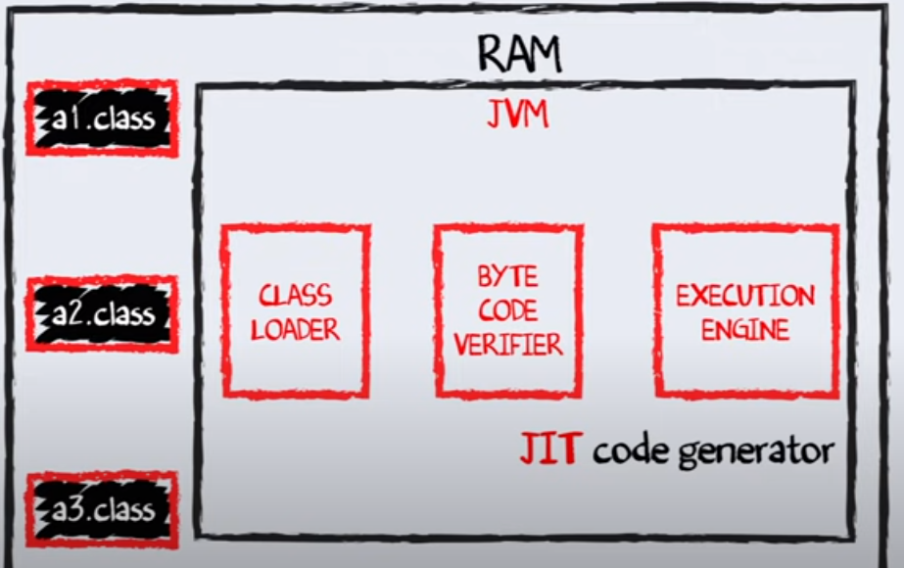

Slide 8
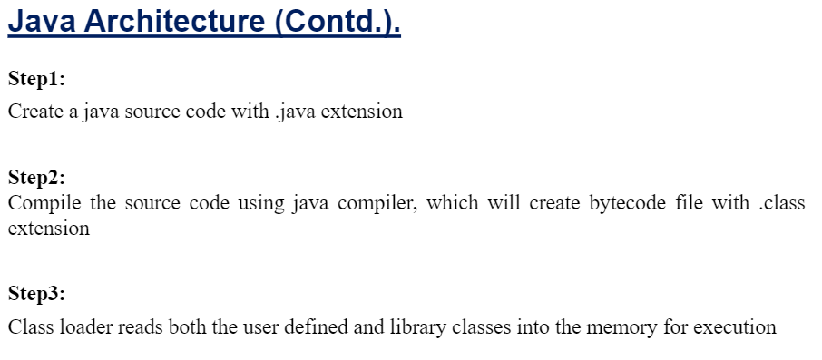
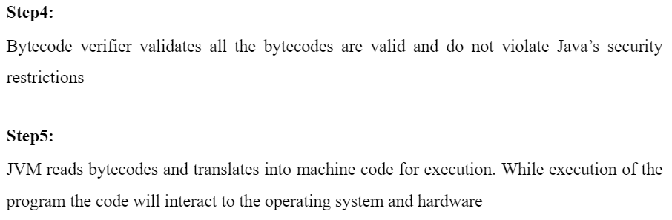

Slide 9
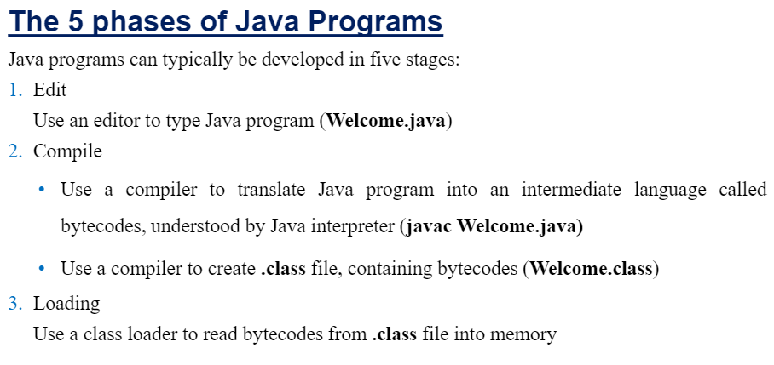
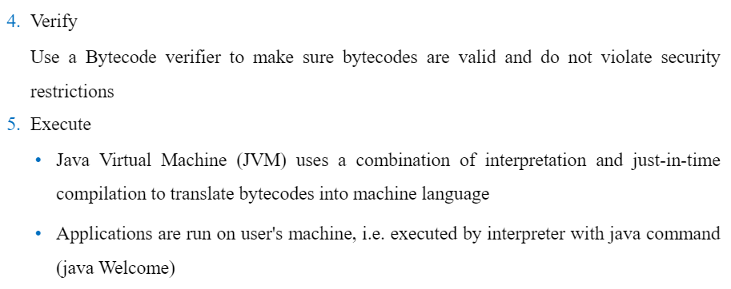

Slide 10
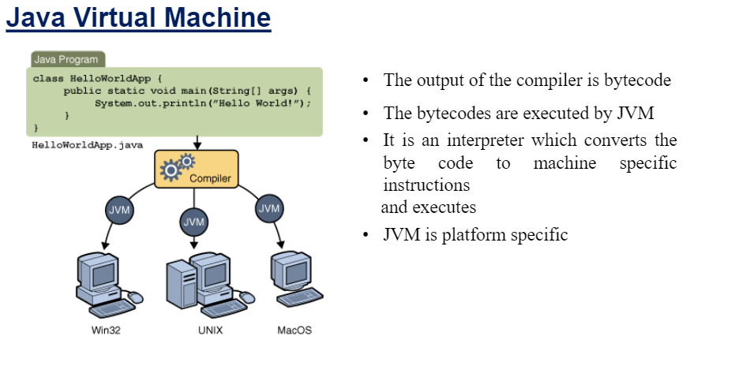

Slide 11
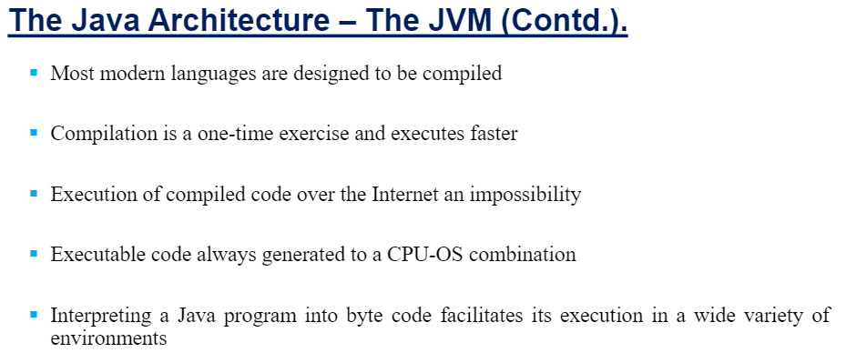
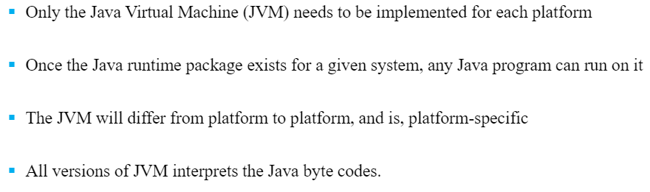
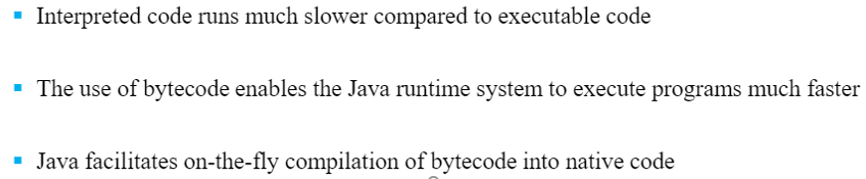

Slide 12
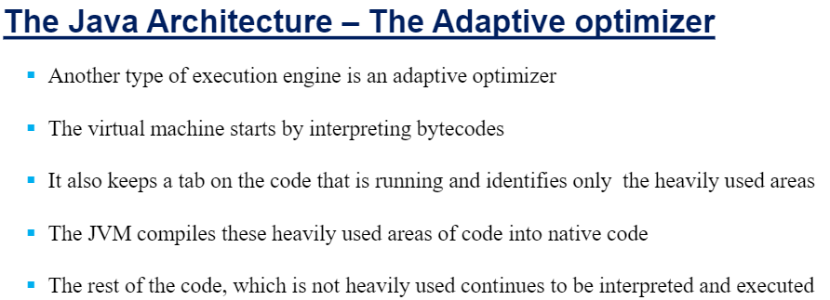

Slide 13
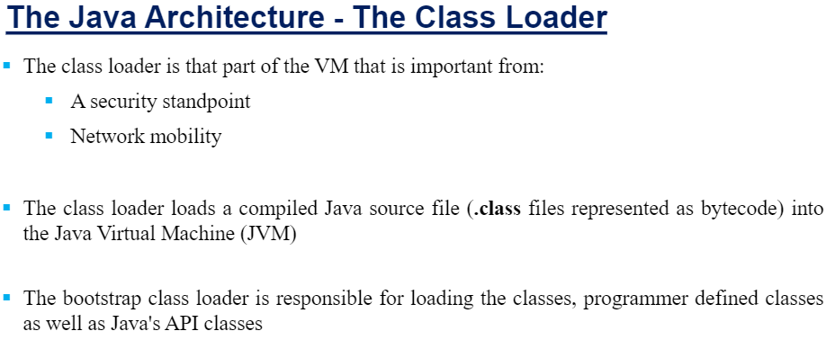

Slide 14
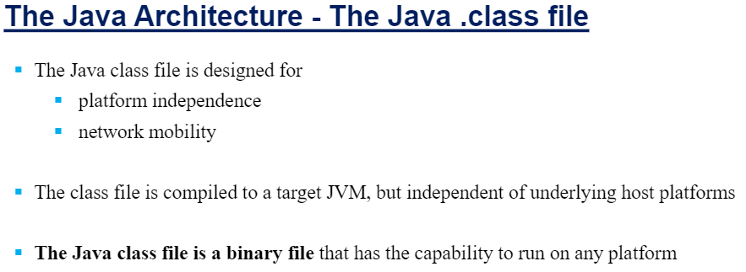

Slide 15
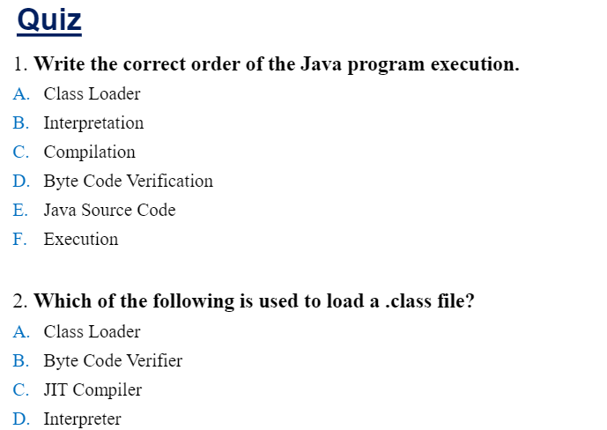
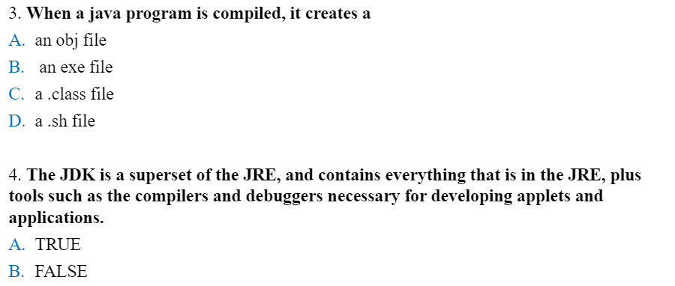

Slide 16
Language Basics

Slide 17
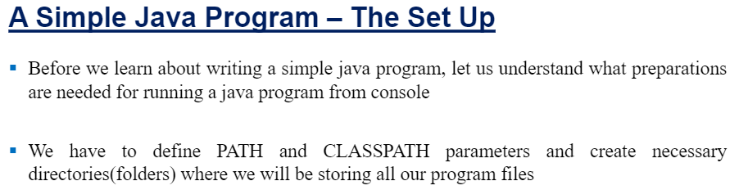
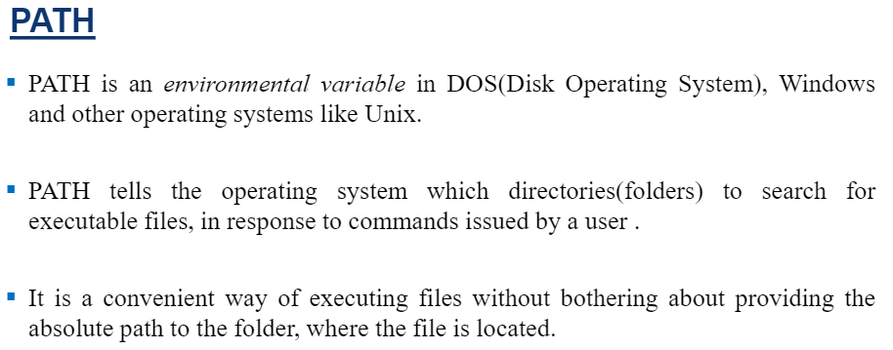

Slide 18
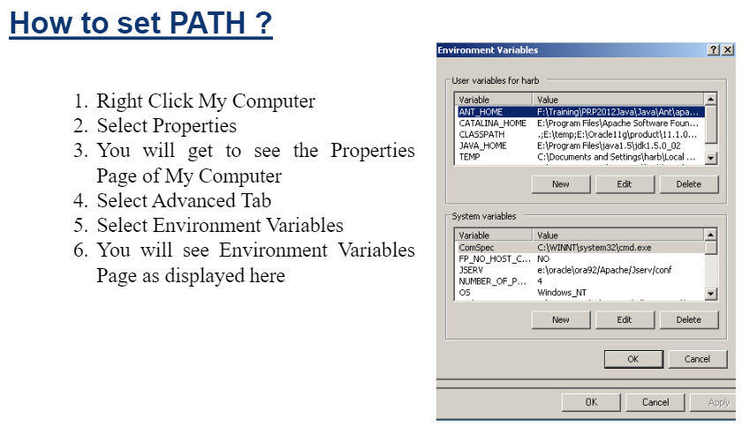

Slide 19
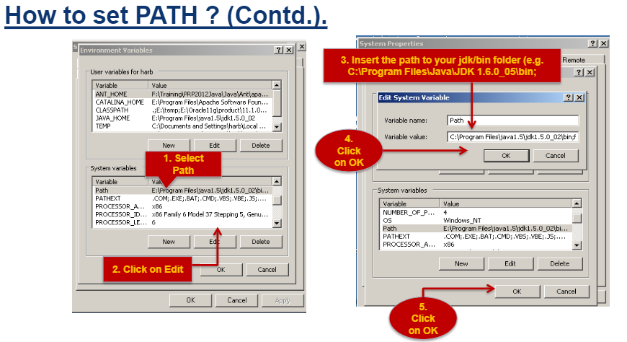

Slide 20
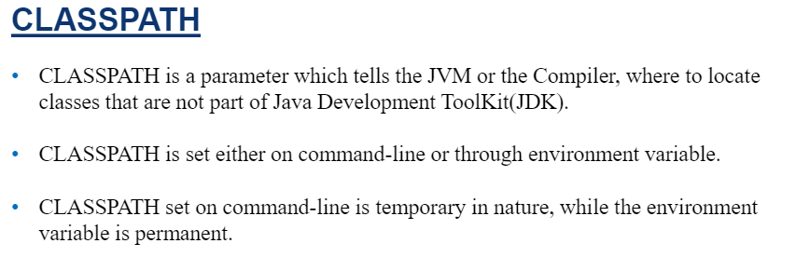

Slide 21
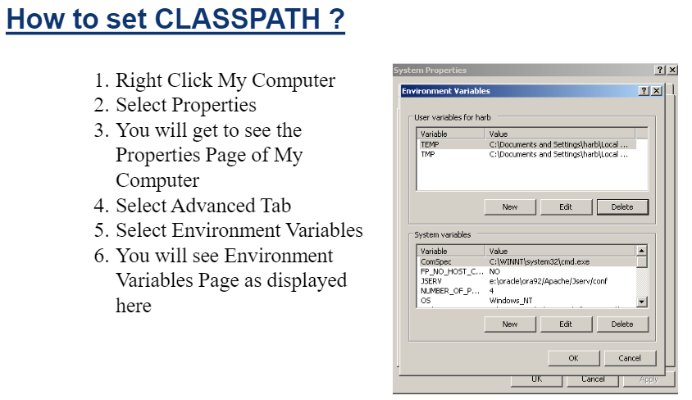

Slide 22
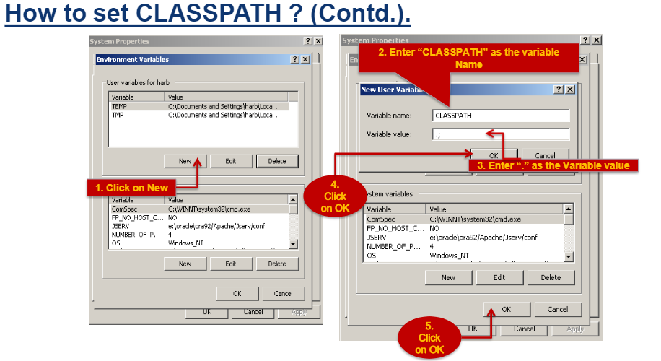

Slide 23
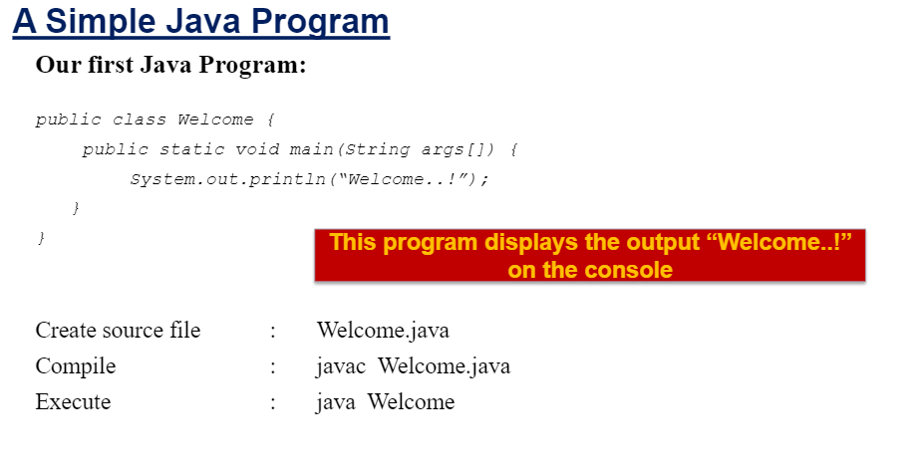

Slide 24
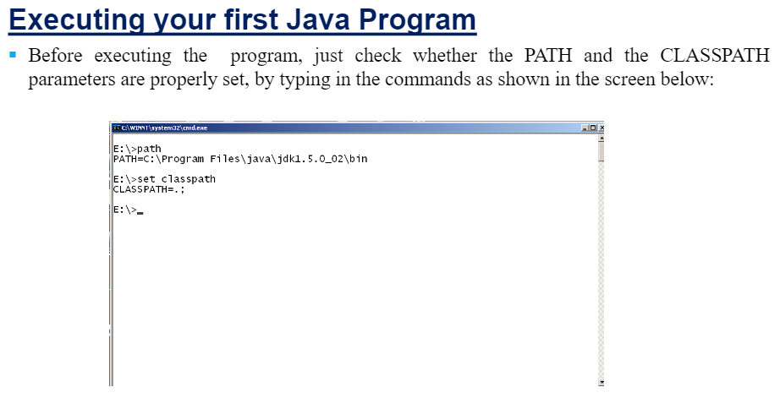

Slide 25
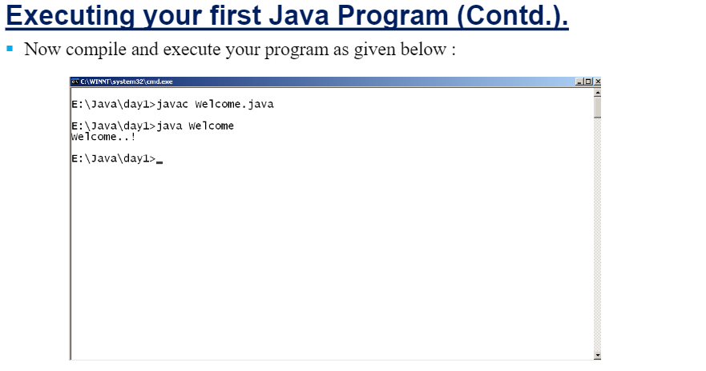

Slide 26
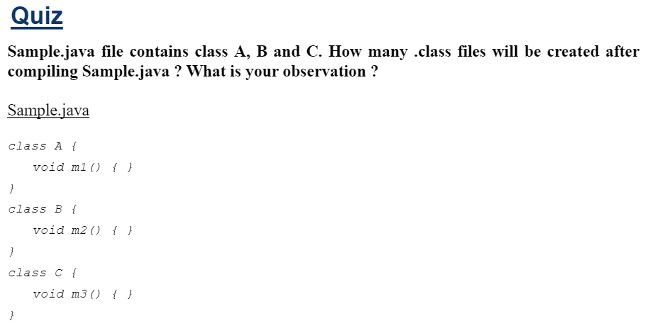

Slide 27
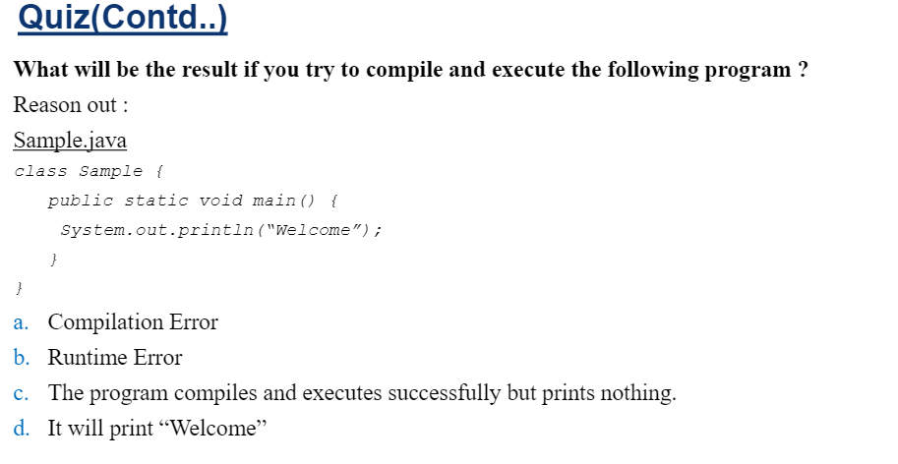

Slide 28
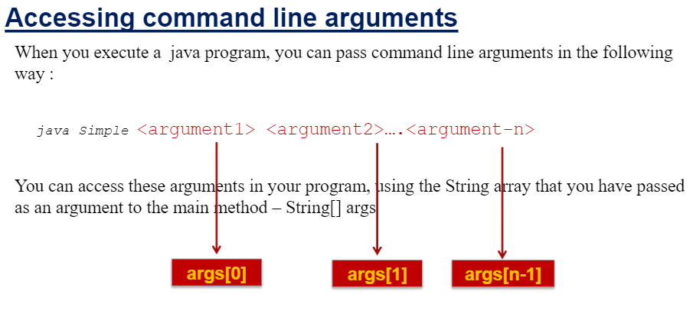

Slide 29
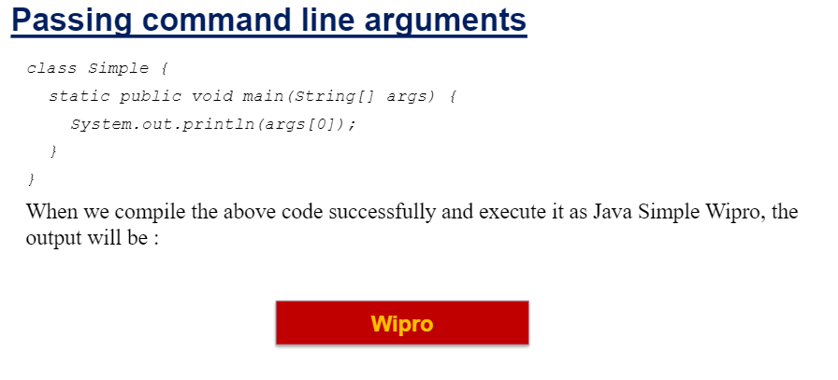

Slide 30
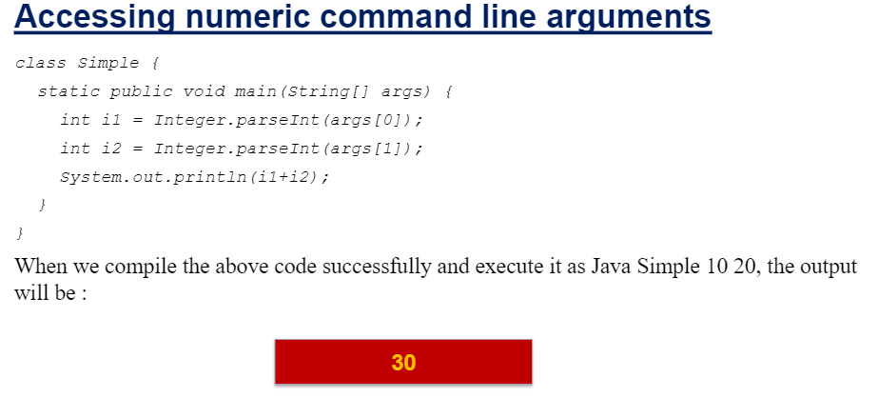

Slide 31
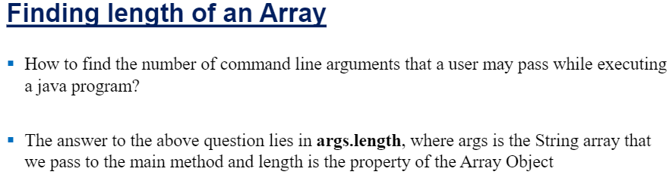
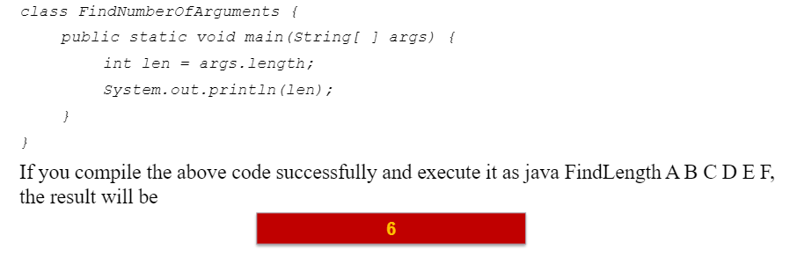


Slide 32
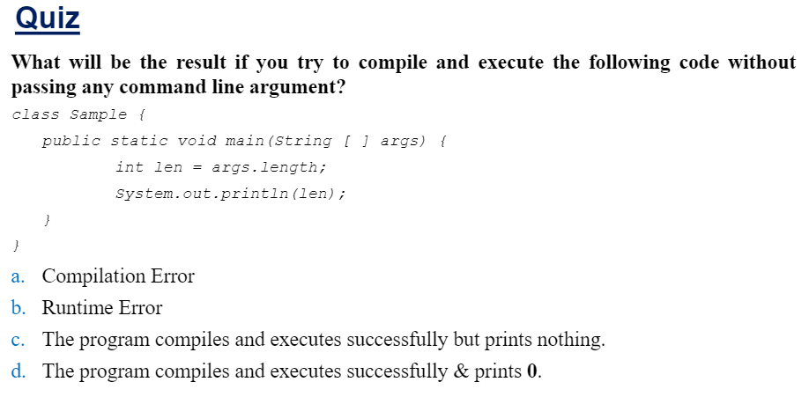

Slide 33
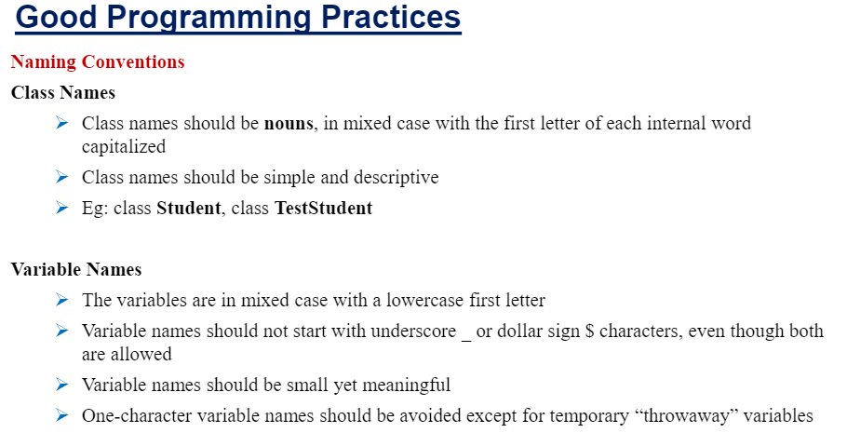

Slide 34
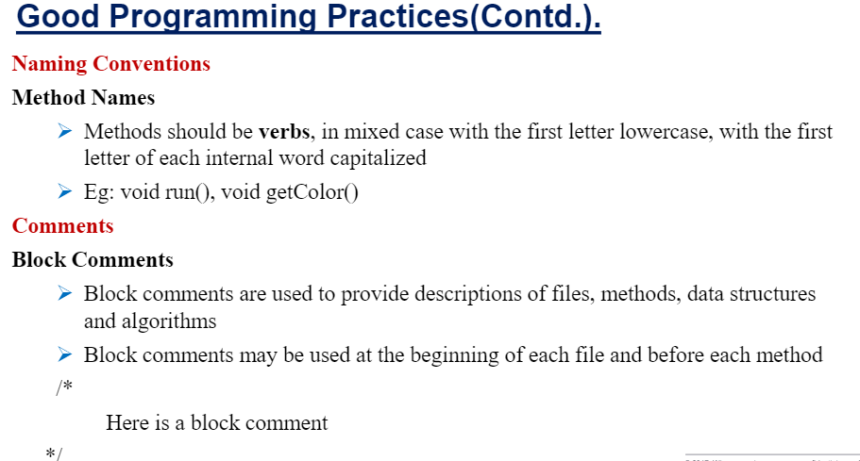

Slide 35
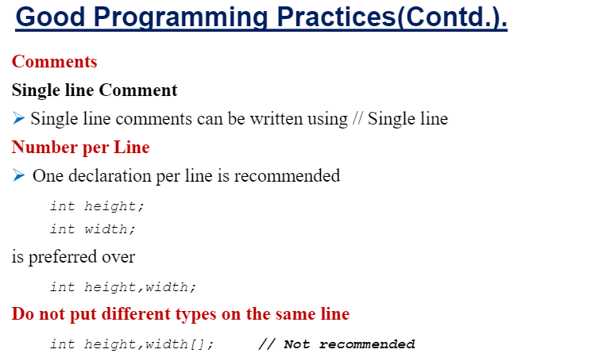

Slide 36
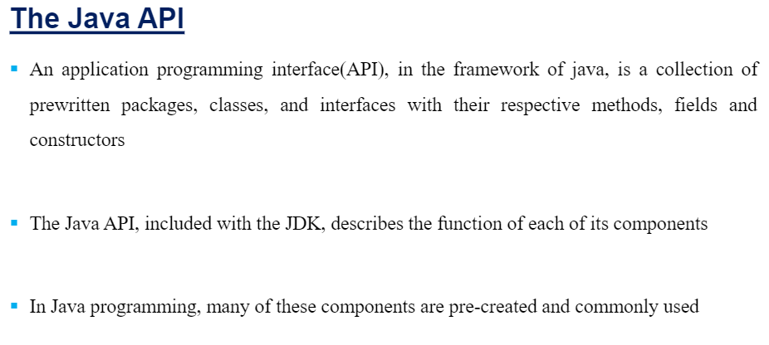

Slide 37
Characteristic of Java
Java Is Simple
Java Is Object-Oriented
Java Is Distributed
Java Is Interpreted
Java Is Robust
Java Is Secure
Java Is Architecture-Neutral
Java Is Portable
Java's Performance
Java Is Multithreaded
Java Is Dynamic
Java is partially modeled on C++, but greatly simplified and improved. Some people refer to Java as "C++--" because it is like C++ but with more functionality and fewer negative aspects.

Slide 38
Characteristic of Java
Java Is Simple
Java Is Object-Oriented
Java Is Distributed
Java Is Interpreted
Java Is Robust
Java Is Secure
Java Is Architecture-Neutral
Java Is Portable
Java's Performance
Java Is Multithreaded
Java Is Dynamic
Java is inherently object-oriented. Although many object-oriented languages began strictly as procedural languages, Java was designed from the start to be object-oriented. Object-oriented programming (OOP) is a popular programming approach that is replacing traditional procedural programming techniques.
One of the central issues in software development is how to reuse code. Object-oriented programming provides great flexibility, modularity, clarity, and reusability through encapsulation, inheritance, and polymorphism.

Slide 39
Characteristic of Java
Java Is Simple
Java Is Object-Oriented
Java Is Distributed
Java Is Interpreted
Java Is Robust
Java Is Secure
Java Is Architecture-Neutral
Java Is Portable
Java's Performance
Java Is Multithreaded
Java Is Dynamic
Distributed computing involves several computers working together on a network. Java is designed to make distributed computing (e.g. Web Services) easy. Since networking capability is inherently integrated into Java, writing network programs is like sending and receiving data to and from a file.

Slide 40
Characteristic of Java
Java Is Simple
Java Is Object-Oriented
Java Is Distributed
Java Is Interpreted
Java Is Robust
Java Is Secure
Java Is Architecture-Neutral
Java Is Portable
Java's Performance
Java Is Multithreaded
Java Is Dynamic
You need an interpreter to run Java programs. The programs are compiled into the Java Virtual Machine code called bytecode. The bytecode is machine-independent and can run on any machine that has a Java interpreter, which is part of the Java Virtual Machine (JVM).

Slide 41
Characteristic of Java
Java Is Simple
Java Is Object-Oriented
Java Is Distributed
Java Is Interpreted
Java Is Robust
Java Is Secure
Java Is Architecture-Neutral
Java Is Portable
Java's Performance
Java Is Multithreaded
Java Is Dynamic
Java compilers can detect many problems that would first show up at execution time in other languages.
Java has eliminated certain types of error-prone programming constructs found in other languages.
Java has a runtime exception-handling feature to provide programming support for robustness.

Slide 42
Characteristic of Java
Java Is Simple
Java Is Object-Oriented
Java Is Distributed
Java Is Interpreted
Java Is Robust
Java Is Secure
Java Is Architecture-Neutral
Java Is Portable
Java's Performance
Java Is Multithreaded
Java Is Dynamic
Java implements several security mechanisms to protect your system against harm caused by stray programs.

Slide 43
Characteristic of Java
Java Is Simple
Java Is Object-Oriented
Java Is Distributed
Java Is Interpreted
Java Is Robust
Java Is Secure
Java Is Architecture-Neutral
Java Is Portable
Java's Performance
Java Is Multithreaded
Java Is Dynamic
Write once, run anywhere
With a Java Virtual Machine (JVM), you can write one program that will run on any platform.

Slide 44
Characteristic of Java
Java Is Simple
Java Is Object-Oriented
Java Is Distributed
Java Is Interpreted
Java Is Robust
Java Is Secure
Java Is Architecture-Neutral
Java Is Portable
Java's Performance
Java Is Multithreaded
Java Is Dynamic
Because Java is architecture neutral, Java programs are portable. They can be run on any platform without being recompiled.

Slide 45
Characteristic of Java
Java Is Simple
Java Is Object-Oriented
Java Is Distributed
Java Is Interpreted
Java Is Robust
Java Is Secure
Java Is Architecture-Neutral
Java Is Portable
Java's Performance
Java Is Multithreaded
Java Is Dynamic
Because Java is architecture neutral, Java programs are portable (moveable). They can be run on any platform without being recompiled.

Slide 46
Characteristic of Java
Java Is Simple
Java Is Object-Oriented
Java Is Distributed
Java Is Interpreted
Java Is Robust
Java Is Secure
Java Is Architecture-Neutral
Java Is Portable
Java's Performance
Java Is Multithreaded
Java Is Dynamic
Multithread programming is smoothly integrated in Java, whereas in other languages you have to call procedures specific to the operating system to enable multithreading.

Slide 47
Characteristic of Java
Java Is Simple
Java Is Object-Oriented
Java Is Distributed
Java Is Interpreted
Java Is Robust
Java Is Secure
Java Is Architecture-Neutral
Java Is Portable
Java's Performance
Java Is Multithreaded
Java Is Dynamic
Java was designed to adapt to an evolving environment. New code can be loaded on the fly without recompilation. There is no need for developers to create, and for users to install, major new software versions. New features can be incorporated transparently as needed.

Slide 48
JDK Versions
JDK 1.0 (Jan. 1996)
JDK 1.1 (Fab. 1997)
JDK 1.2 (Dec. 1998)
JDK 1.3 (May 2000)
JDK 1.4 (Feb. 2002)
JDK 1.5 (Sep. 2004)
JDK 1.6 (Dec. 2006)
JDK 1.7 (July 2011)
JDK 1.8 (Mar. 2014)
JDK 9 (Sep. 2017)
JDK 10 (Mar. 2018)
JDK 11 (Sep. 2018)
JDK 12 (Mar. 2019)
JDK 13 (Sep. 2019)
JDK 14 (Mar. 2020)
JDK 15 (Sep. 2020)
Java 20 or JDK 20 released on March, 21st 2023

Slide 49
JDK Editions
Java Standard Edition (J2SE)
J2SE can be used to develop client-side standalone (independant) applications or applets.
Java Enterprise Edition (J2EE)
J2EE can be used to develop server-side applications such as Java servlets and Java ServerPages.
Java Micro Edition (J2ME).
J2ME can be used to develop applications for mobile devices such as cell phones.

Slide 50
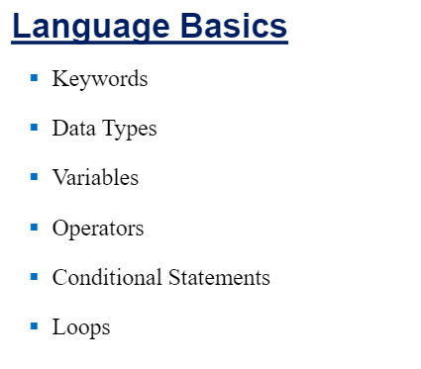

Slide 51
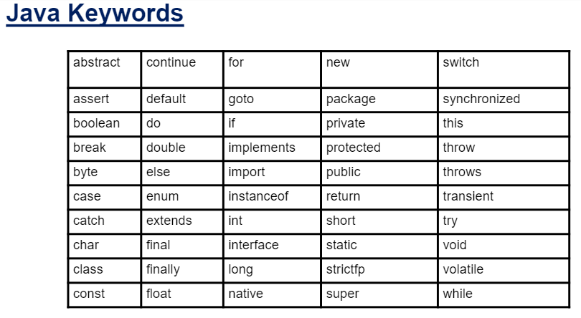

Slide 52
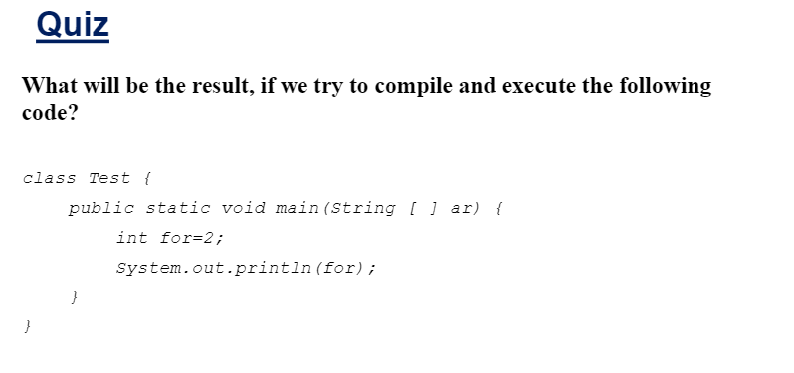

Slide 53
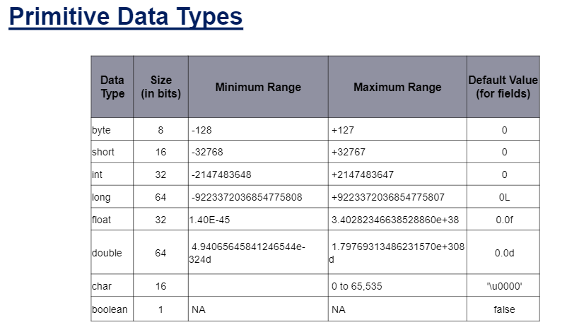

Slide 54
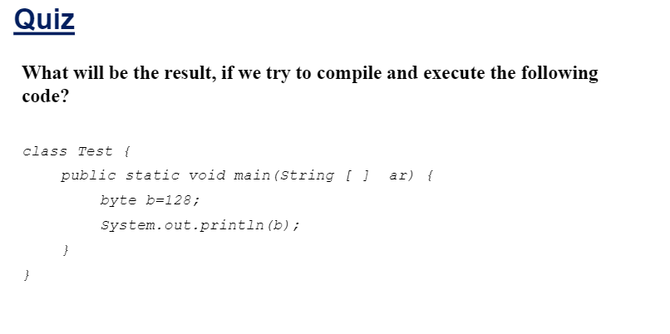
// This line will result in a compilation error

Slide 55
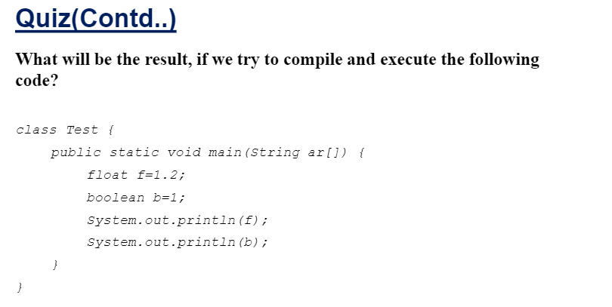
// Error: Cannot assign an integer value to a boolean variable
boolean b = (1 == 2); // Assigns false because the condition (1 == 2) is false

Slide 56
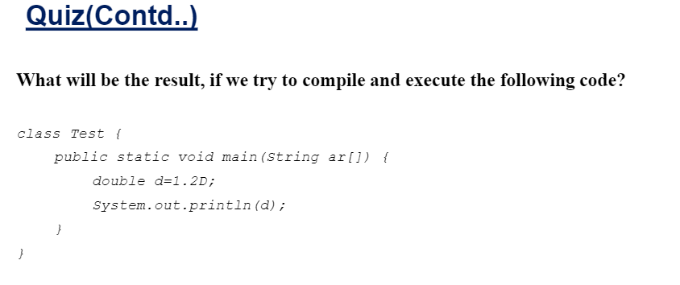

Slide 57
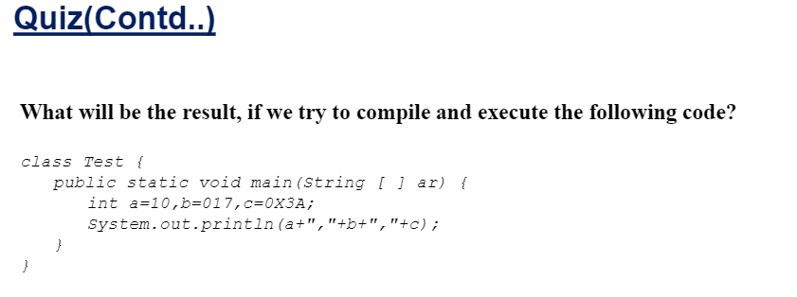
// Decimal: 10
// Octal: 1*8^1 + 7*8^0 = 15 (decimal)
// Hexadecimal: 3*16^1 + A(10 in decimal)*16^0 = 58 (decimal)

Slide 58
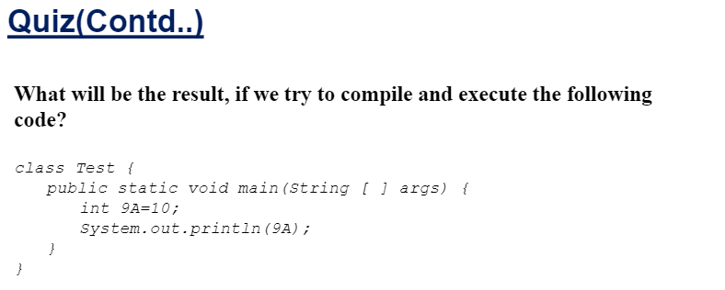
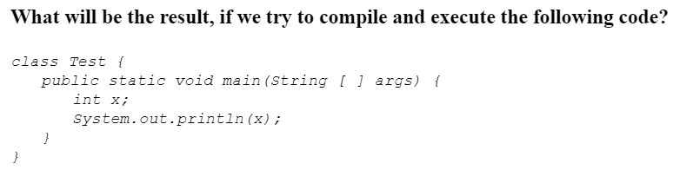
int a9 = 10; // Valid variable name

Slide 59


Slide 60

Static Variable: 10 Instance Variable: 5 Local Variable: 2 Static Variable: 20 Instance Variable: 5 Local Variable: 2

Slide 61


Slide 62





Slide 63


Slide 64





Slide 65




Slide 66





Slide 67



Slide 68
https://www.youtube.com/embed/HBnB69yFf_4
https://www.youtube.com/embed/f5YdkIzNmfM
https://www.youtube.com/embed/ss7BtLrbxp4

